Slide 1
Mega Project | July 2026
Vehicle Wear & Tear Prediction System

Slide 2
Vehicle Wear & Tear Prediction System
Agenda
AGENDA
Project Overview Dataset Tech Stack & Python Concepts Used Output Report / Dashboard Summary Future Scope
EDAG Electrics/Electronics Author: I&V Team Version:1.0 Scope: EDAG Group internal
2

Slide 3
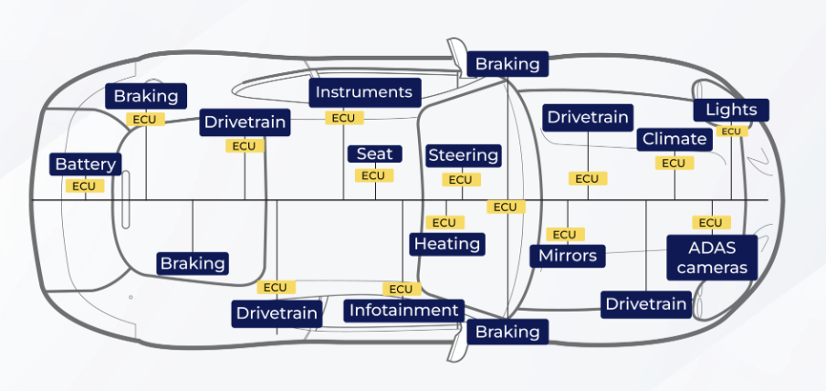
1. Project Overview
1.1 What Does This System Do?
Loads vehicle sensor readings, owner details, and service history from a multi-sheet Excel dataset
Compares each sensor reading against defined Green / Yellow / Red threshold ranges to flag its condition
Calculates an overall Vehicle Health Score (0–100%) and generates maintenance recommendations
Produces an automated PDF Health Report with a sensor comparison table, status pie chart, and a plain-language condition summary
EDAG Electrics/Electronics Author: I&V Team Version:1.0 Scope: EDAG Group internal
3

Slide 4
2. Dataset
2.1 Dataset Description
Multi-sheet Excel workbook (Vehicle_Health_System_Data.xlsx) with 5 linked sheets
Standard_Thresholds — Green/Yellow/Red range for every monitored parameter
Vehicle_Dummy_Data — 12 live sensor readings per vehicle (engine, brakes, battery, coolant, RPM, etc.)
Vehicle_Master, Vehicle_Details & Service_History — owner info, vehicle specs, and past service records
All sheets are linked by a common Vehicle_ID for lookup and cross-referencing
Data Set :- https://shorturl.at/M89Kb
GitHub :- https://shorturl.at/1IEHo
EDAG Electrics/Electronics Author: I&V Team Version:1.0 Scope: EDAG Group internal

Slide 5
3. Tech Stack & Python Concepts Used
3.1 Tech Stack & Key Concepts
Used:
Python (Modular & OOP-style Design) — each task in its own module: loader, comparator, scorer,
recommender, PDF generator
Pandas — reads and processes the multi-sheet Excel dataset
Dictionaries & Conditional Logic — Green/Yellow/Red threshold rules and status checks
Matplotlib — generates the sensor-status pie chart
Report Lab — builds the final PDF health report
List Comprehension & String Formatting — builds summaries, recommendations, and dynamic report text
EDAG Electrics/Electronics Author: I&V Team Version:1.0 Scope: EDAG Group internal
5

Slide 6
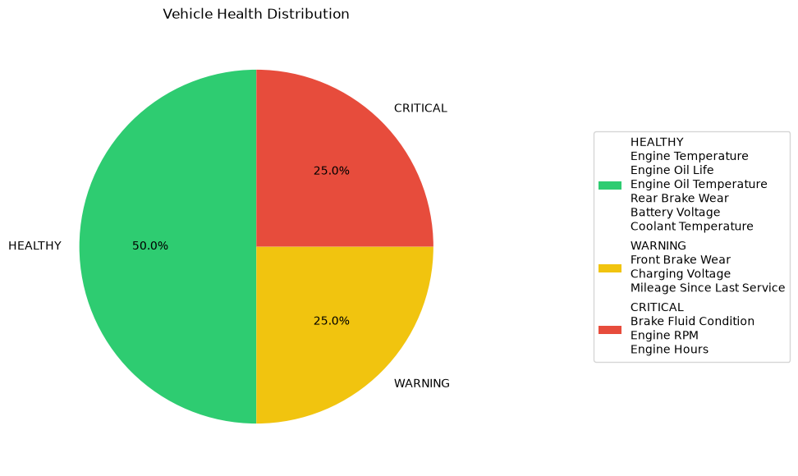
4. Output Report
4.1 PDF Health Report Contents
Vehicle & owner details — ID, number, make/model, contact info, last & next service dates
Sensor comparison table — every parameter's Green/Yellow/Red range vs. this vehicle's actual reading
Health Score — overall percentage summarizing vehicle condition
Status distribution pie chart — visual split of GREEN / YELLOW / RED sensors
Narrative condition summary — plain-language paragraphs plus specific recommendations
EDAG Electrics/Electronics Author: I&V Team Version:1.0 Scope: EDAG Group internal

Slide 7
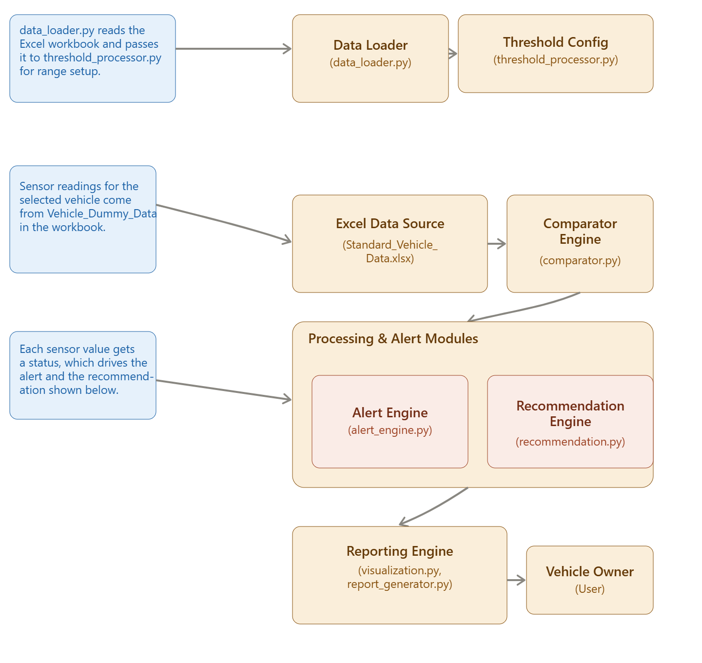
5. Component diagram

Slide 8
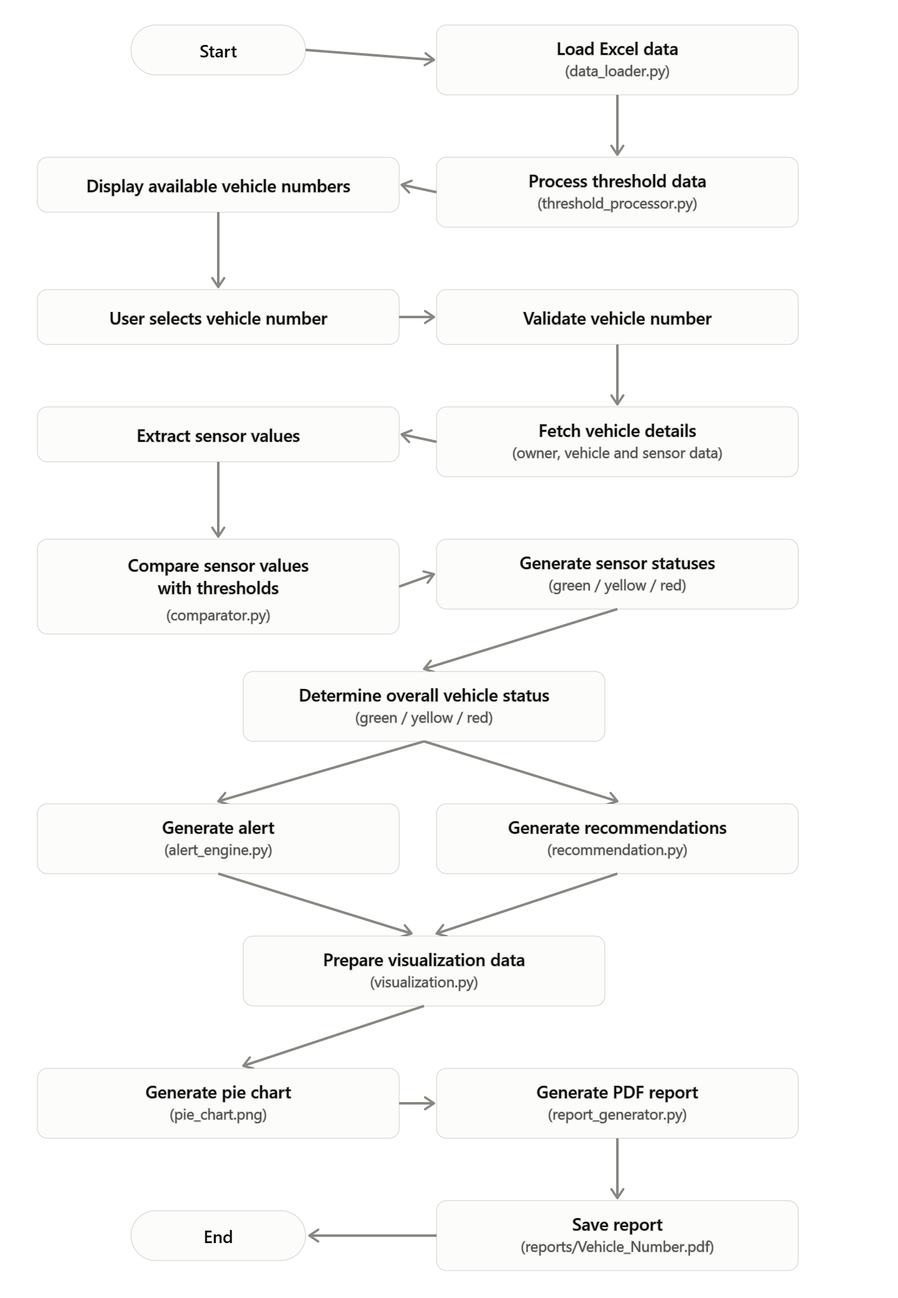
6. Flow diagram

Slide 9
THANK YOU

